Slide 1
QISKIT HACKATHON TEAM: NaKhIs Islam Nizami Khayala Hatamova Nazanin Ghaemi

Slide 2
Why Quantum Key Distribution?
CLASSICAL SECURITY
Depends on the math hardness
Breakable by future QC
QUANTUM SECURITY
Depends on physics laws
Information-theoretically secure

Slide 3

What is BB84?

Slide 4
First QKD protocol (1984) Goal: Establish secret key + detect eavesdropping Uses Z and X bases to encode bits Wrong‑basis measurement introduces errors

Slide 5
Quantum Concepts Used
|0⟩, |1⟩ qubit states
|+⟩, |−⟩ = superposition states
Z basis = computational
X basis = Hadamard
Measurement collapses state → detects Eve

Slide 6
System Architecture
Alice generates bits + bases
Bob measures with random bases
Sifting keeps matching basis bits
QBER estimation
Privacy amplification using Toeplitz universal hash instead of SHA‑256
Qiskit Aer simulation

Slide 7
Eavesdropping Detection
Eve intercepts ~30% qubits
Wrong basis introduces errors
QBER rises and signals attack

Slide 8
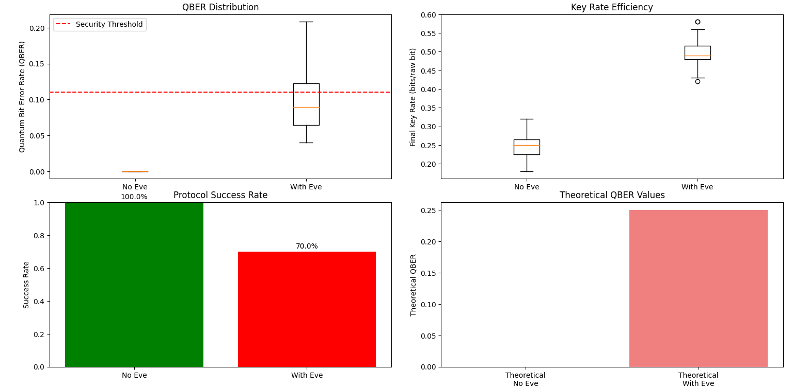

Slide 9
THANKS FOR YOUR ATTENTION!

